Slide 1

INSTITUTE : UIE
DEPARTMENT : CSE
Bachelor of Engineering (Computer Science & Engineering)
PROJECT BASED LEARNING IN JAVA
(20CST-319/20ITT-319)
TOPIC OF PRESENTATION:
Introduction to Exceptions. Difference between error and exception
DISCOVER . LEARN . EMPOWER

Slide 2

Lecture Objectives
In this lecture, we will discuss:
Introduction to Exceptions. Difference between error and exception.

Slide 3
JAVA - EXCEPTIONS
An exception (or exceptional event) is a problem that arises during the execution of a program.
When an Exception occurs the normal flow of the program is disrupted and the program/Application terminates abnormally, which is not recommended, therefore, these exceptions are to be handled.
An exception can occur for many different reasons. Following are some scenarios where an exception occurs.
A user has entered an invalid data.
A file that needs to be opened cannot be found.
A network connection has been lost in the middle of communications or the JVM has run out of memory.
Some of these exceptions are caused by user error, others by programmer error, and others by physical resources that have failed in some manner.

Slide 4
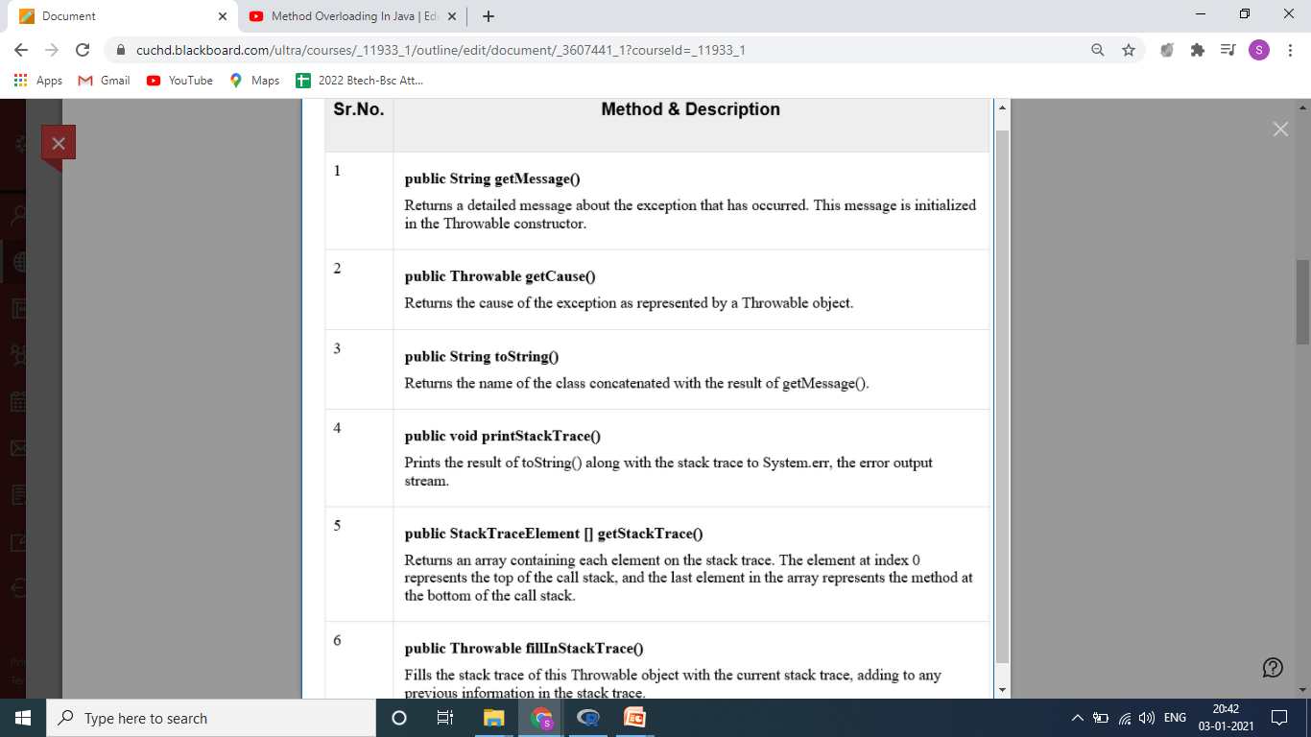
Exceptions Methods
Following is the list of important methods available in the Throwable class.

Slide 5
Error v/s Exception
Error: An Error indicates serious problem that a reasonable application should not try to catch.
Exception: Exception indicates conditions that a reasonable application might try to catch.
Exception Hierarchy :
All exception and errors types are subclasses of class Throwable, which is base class of hierarchy.
One branch is headed by Exception. This class is used for exceptional conditions that user programs should catch.
NullPointerException is an example of such an exception.
There is an important subclass of Exception, called RuntimeException.Exceptions of this type are automatically defined for the programs that you write and include things such as division by zero and invalid array indexing.

Slide 6
Exception and Error
Exceptions and errors both are subclasses of Throwable class. The error indicates a problem that mainly occurs due to the lack of system resources and our application should not catch these types of problems. Some of the examples of errors are system crash error and out of memory error. Errors mostly occur at runtime that's they belong to an unchecked type.
Exceptions are the problems which can occur at runtime and compile time. It mainly occurs in the code written by the developers. Exceptions are divided into two categories such as checked exceptions and unchecked exceptions.

Slide 7
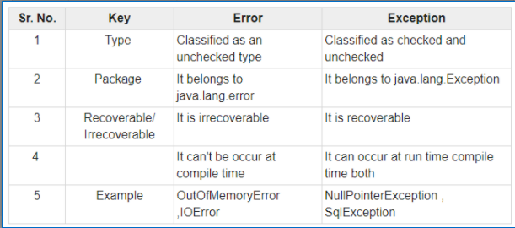

Slide 8
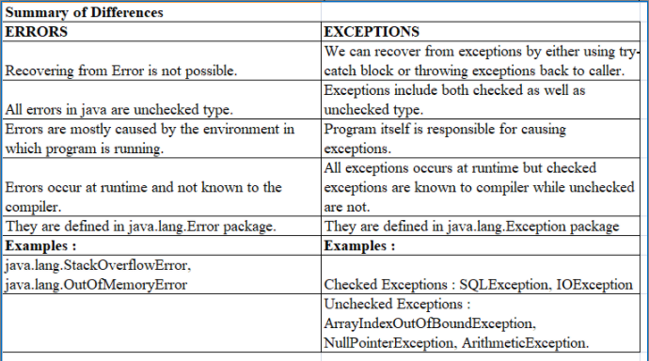

Slide 9
Example of Error
public class ErrorExample {
public static void main(String[] args){
recursiveMethod(10)
}
public static void recursiveMethod(int i){
while(i!=0){
i=i+1;
recursiveMethod(i);
}
}
}
Output
Exception in thread "main" java.lang.StackOverflowError
at ErrorExample.ErrorExample(Main.java:42)

Slide 10
Example of Exception
public class ExceptionExample {
public static void main(String[] args){
int x = 100;
int y = 0;
int z = x / y;
}
}
Output
java.lang.ArithmeticException: / by zero
at ExceptionExample.main(ExceptionExample.java:7)

Slide 11
QUIZ:
1. When does Exceptions in Java arises in code sequence? a) Run Time b) Compilation Time c) Can Occur Any Time d) None of the mentioned

Slide 12
Summary:
In this session, you were able to :
• Learn about Introduction to Exceptions. Difference between error and exception

Slide 13
References:
Books:
1. Balaguruswamy, Java.
2. A Primer, E.Balaguruswamy, Programming with Java, Tata McGraw Hill Companies
3. John P. Flynt Thomson, Java Programming.
ONLINE NOTES LINKS:
https://www.tutorialspoint.com/java/java_exceptions.htm
https://www.javatpoint.com/exception-handling-in-java
https://www.geeksforgeeks.org/exceptions-in-java/
https://beginnersbook.com/2013/04/java-exception-handling/
https://docs.oracle.com/javase/tutorial/essential/exceptions/definition.html
VIDEO LINKS:
https://www.javatpoint.com/exception-handling-in-java
https://www.edureka.co/blog/java-exception-handling
https://marcus-biel.com/advanced-exception-handling-in-java/

Slide 14
THANK YOU

